Slide 1
Docker Swarm 101
By Chetan Shah

Slide 2
Docker Swarm

Slide 3
What is Docker Swarm?
Docker Swarm is a clustering and scheduling tool for Docker containers
With Docker Swarm - IT administrators and developers can establish and manage a cluster of Docker nodes as a single virtual system
A swarm is a group of machines that are running Docker Daemon and connected into a cluster

Slide 4
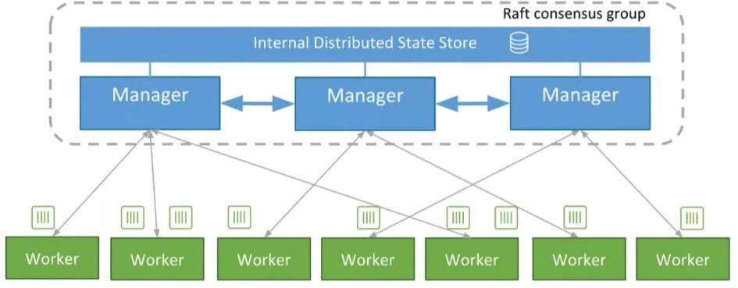
Docker Swarm - Architecture

Slide 5
Docker Swarm - diving deeper
Cluster management integrated with Docker Engine
Use the Docker Engine CLI to create a swarm of Docker Engines where you can deploy application services
Declarative service model
Uses a declarative approach to let you define the desired state of the various services in your application stack
Scaling
When you scale up or down, the swarm manager automatically adapts by adding or removing tasks to maintain the desired state
Desired state reconciliation
Swarm manager node constantly monitors the cluster state and reconciles any differences between the actual state and your expressed desired state
Service discovery
Swarm manager nodes assign each service in the swarm a unique DNS name and load balances running containers
Rolling updates
At rollout time you can apply service updates to nodes incrementally. If anything goes wrong, you can roll-back a task to a previous version of the service

Slide 6
Docker Swarm - diving deeper
Service discovery
Swarm manager nodes assign each service in the swarm a unique DNS name and load balances running containers
Rolling updates
At rollout time you can apply service updates to nodes incrementally.
If anything goes wrong, you can roll-back a task to a previous version of the service

Slide 7
Docker - Cleanup Commands
# Remove all stopped containers
docker container prune
# Remove all unused volumes
docker volume prune
# Remove unused images
docker image prune
# Remove unused network
docker network prune
­# Remove all unused containers, volumes, images (in this order)
docker system prune

Slide 8
Docker - Common Commands
#Detailed list of information regarding docker and your system
docker system info
#Will show you how many images, containers and local volumes exist on the system, how many of them are used and the amount of memory that could be recovered if the prune command is used (without the -a option)
docker system dfdocker ps list running containers.
Llist all container including stopped container
docker ps
Ddownload a image from Docker Hub registry. Link to the docker image is always shown on the right at dockerhub.
docker pull

Slide 9
Docker - Common Commands
This is used to build your own container based on a Dockerfile. Common use is docker build . to build a container based on the Dockerfile in the current directory (the dot). docker build -t "myimage:latest" . creates a container and stores the image under the given name
docker build
Shows all local storage images
docker images
Run a docker container based on an image, i. e. docker run myimage -it bash. If no local image can be found docker run automatically tries to download the image from Docker hub.
docker run
Display the logs of a container, you specified. To continue showing log updates just use docker logs -f mycontainer
docker logs

Slide 10
Docker - Common Commands
List the volumes, which are commonly used for persisting data of Docker containers.
docker volume ls
List all networks available for docker container
docker network ls
Add the container to the given container network. That enables container communication by simple container name instead of IP
docker network connect
Remove one or more containers
docker rm mycontainer #but make sure the container is stopped
Remove one or more images
docker rmi myimage #but make sure no running container is based on that image

Slide 11
Docker - Common Commands
Stop one or more containers.
docker stop mycontainer v#stops one container
Stop all running containers
docker stop $(docker ps -a -q)
Start a stopped container using the last state
docker start

